Slide 1
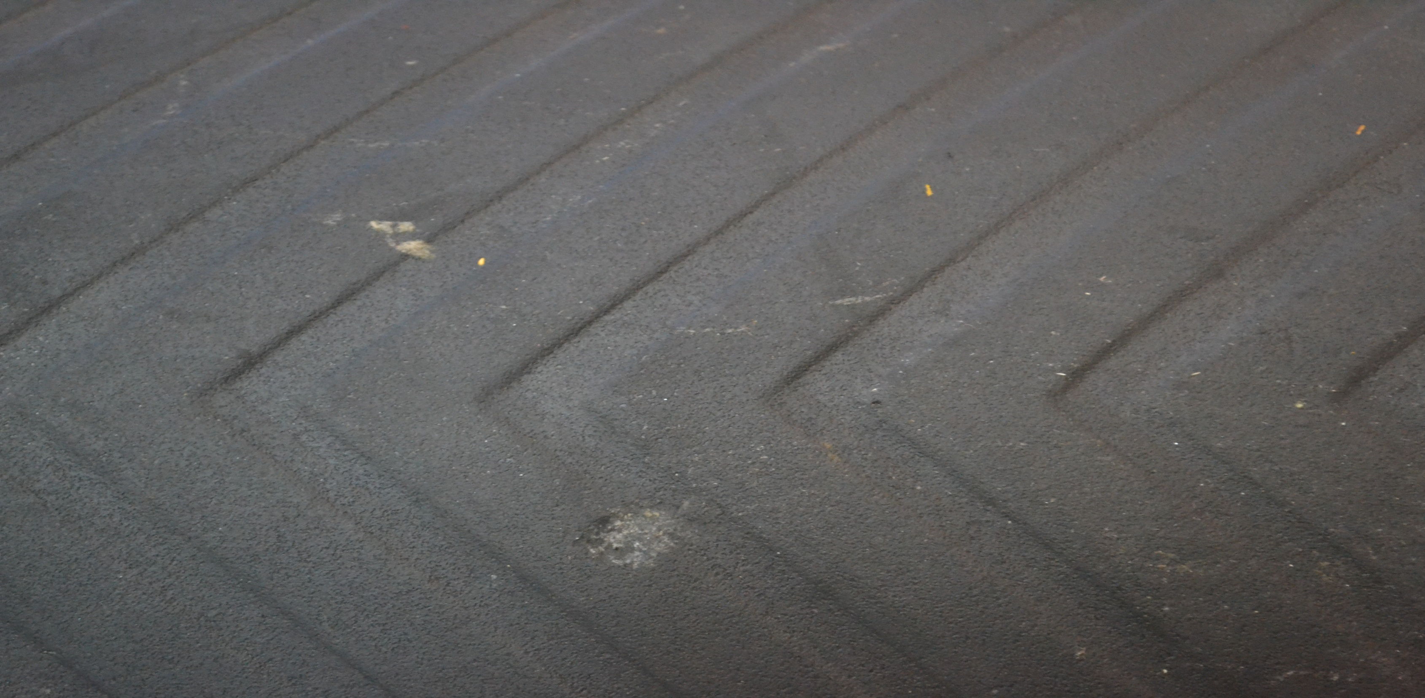
Counterweight changes to perform

Slide 2
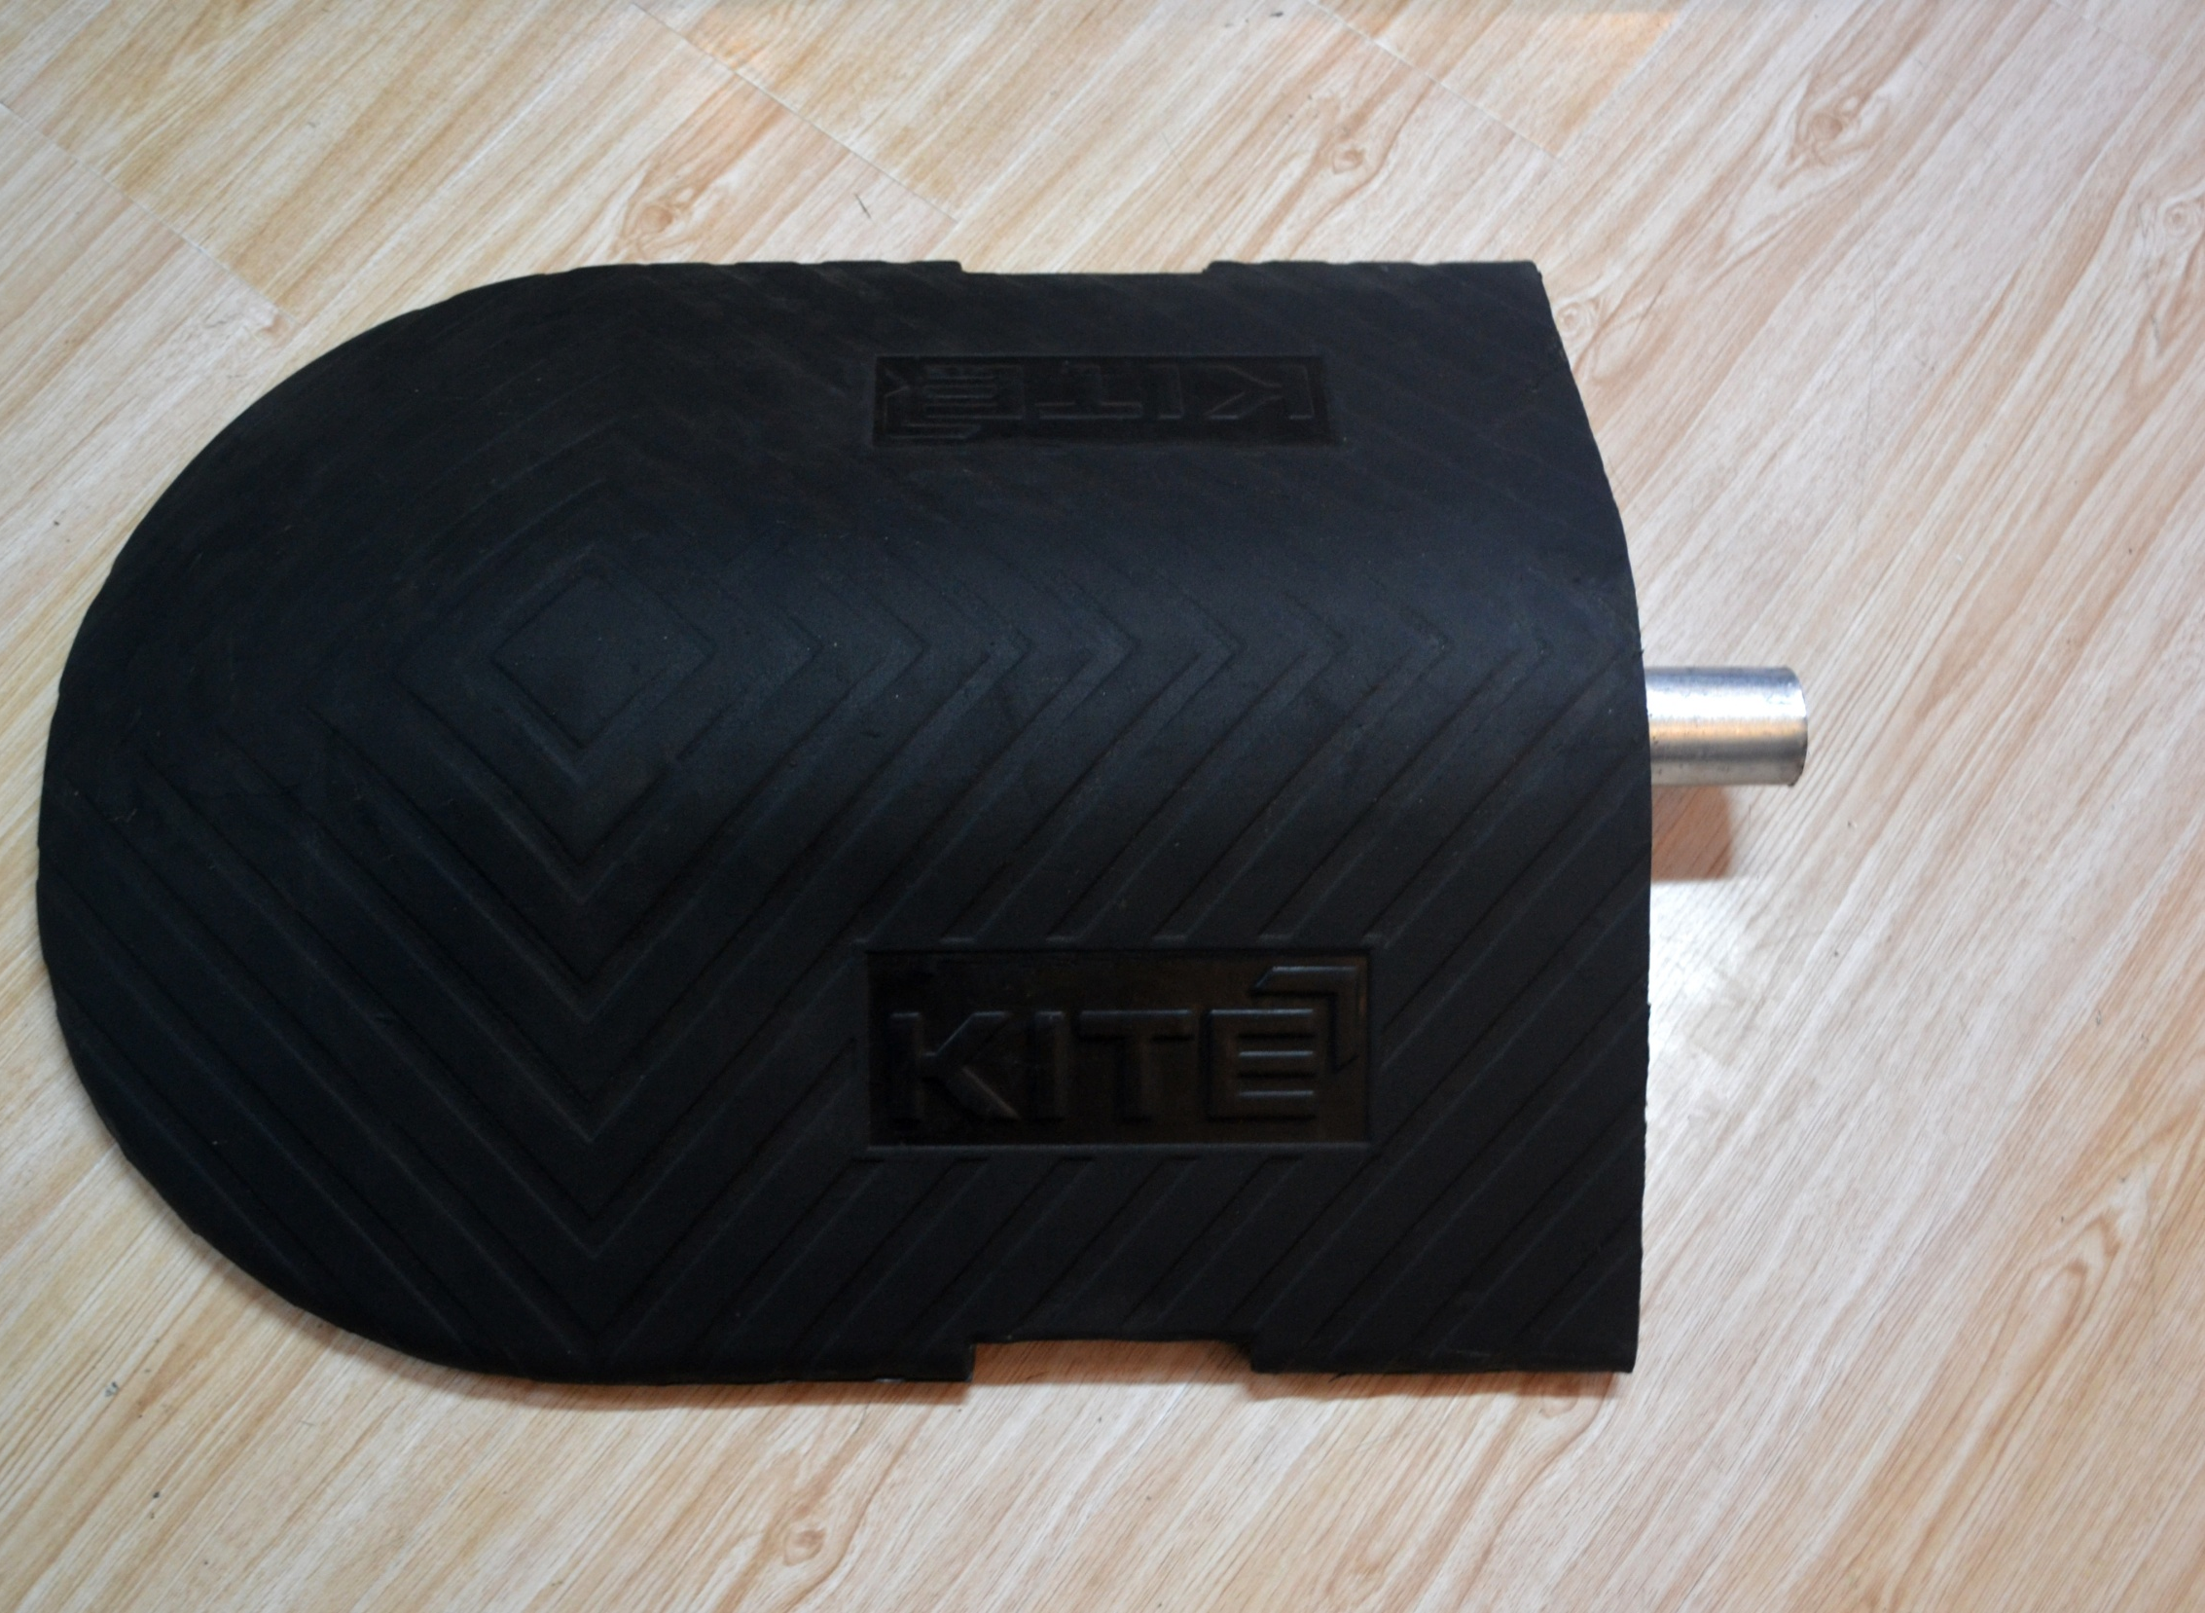
The weight should be between 25.2 and 25.5 KG (If more, we don't pay for it. But not more than 27 KG).

Slide 3
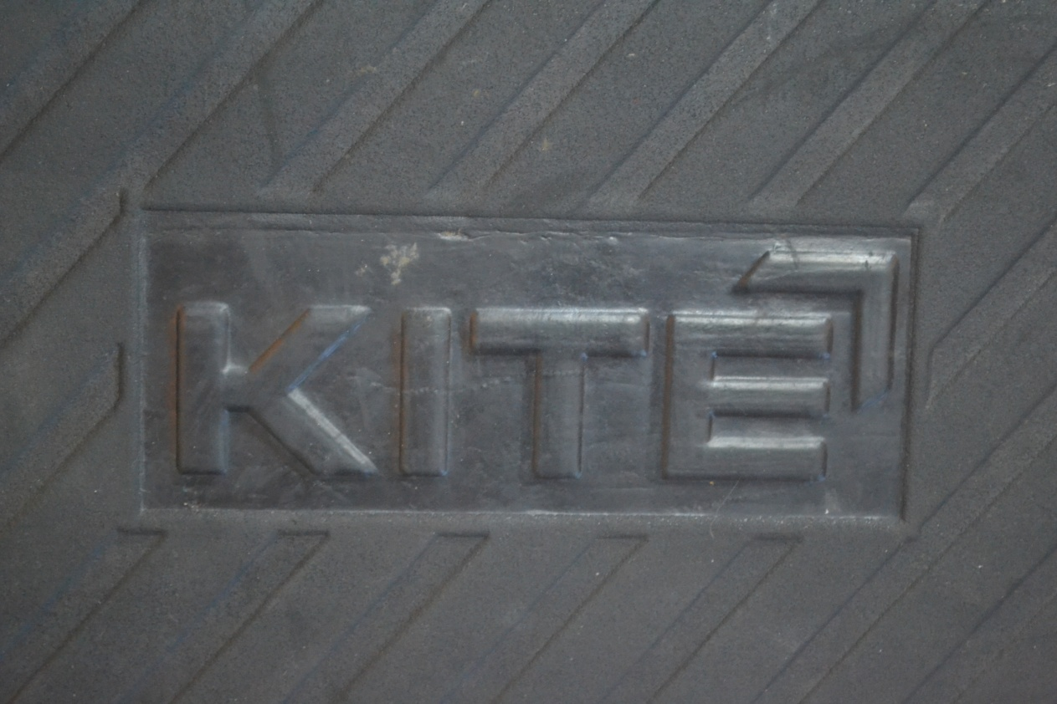
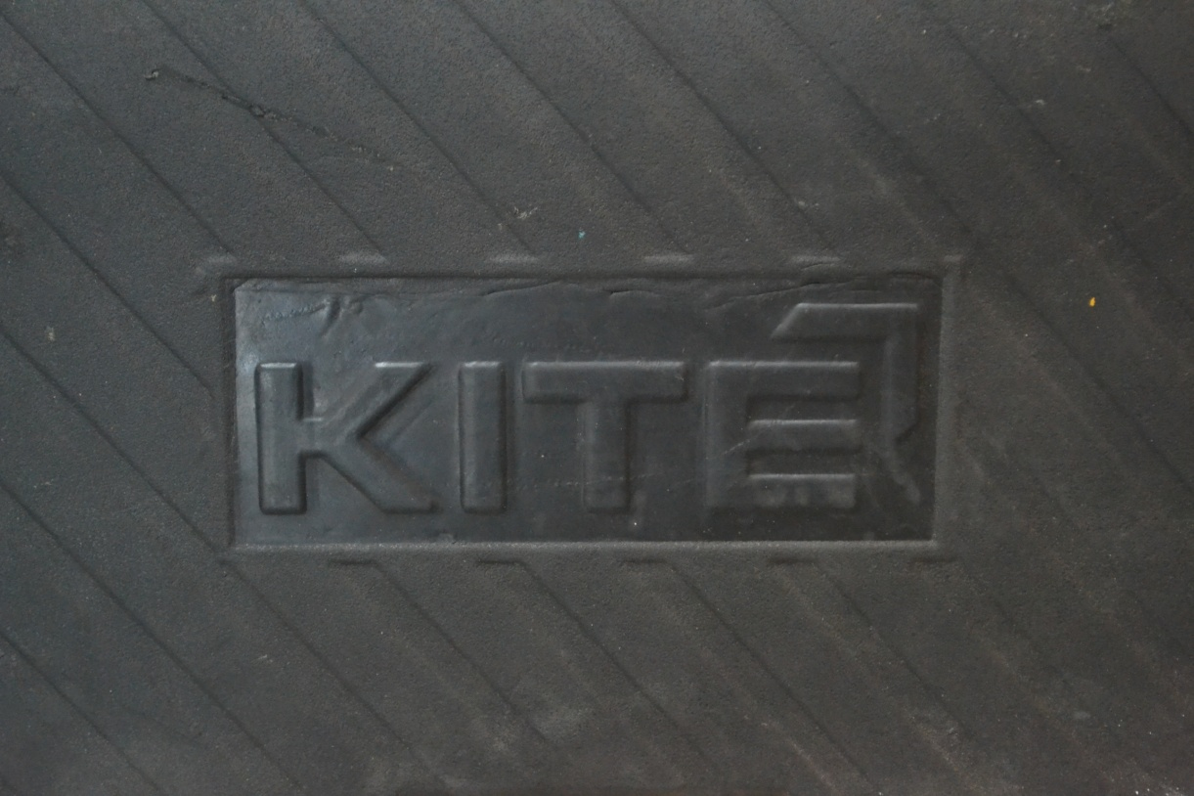
The client's Logo should be more clear.

Slide 4
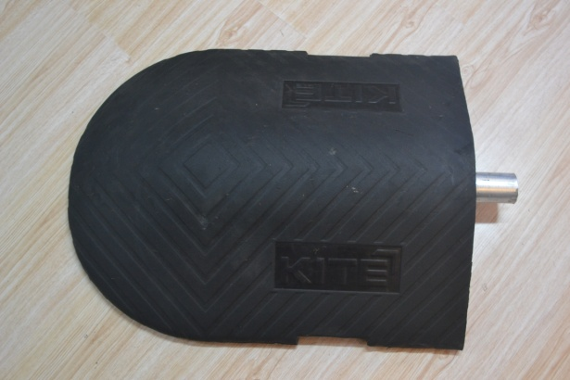
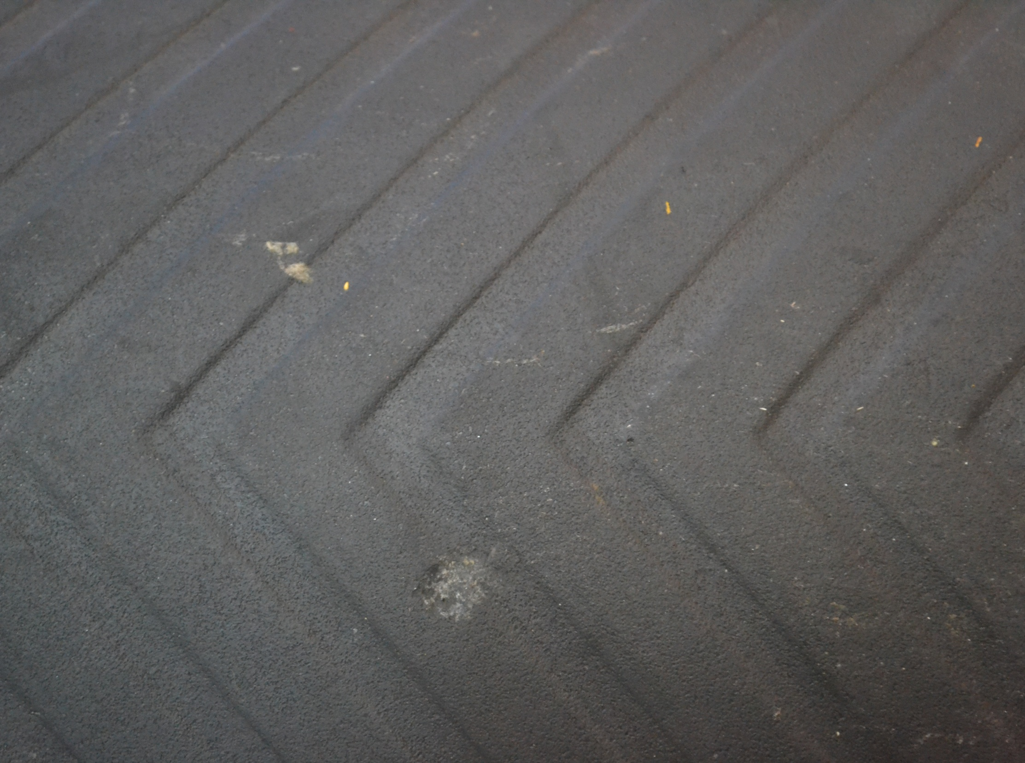
The surface of the rubber counterweight should be kept cleaned and NOT be damaged.

Slide 5
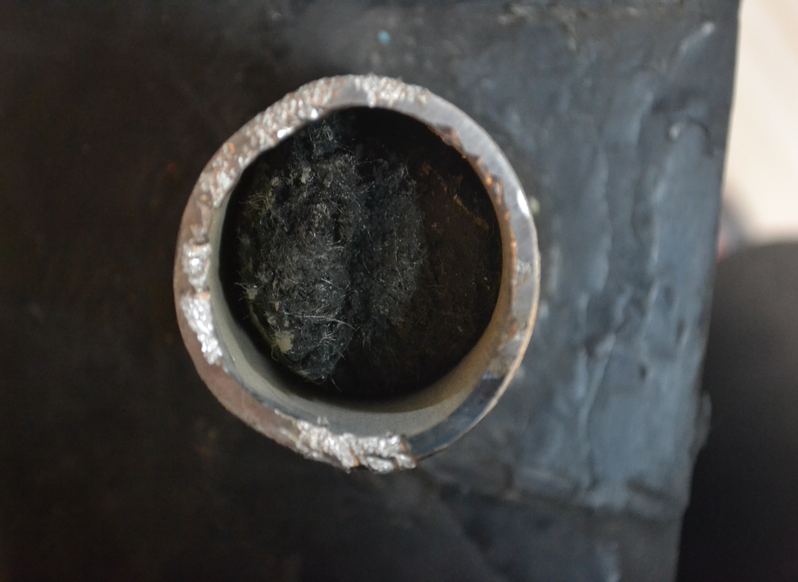
The tube should be rounded and not damaged. Also, the tube should be cut very straight.
The tube should NOT be filled with rubber.

Slide 6
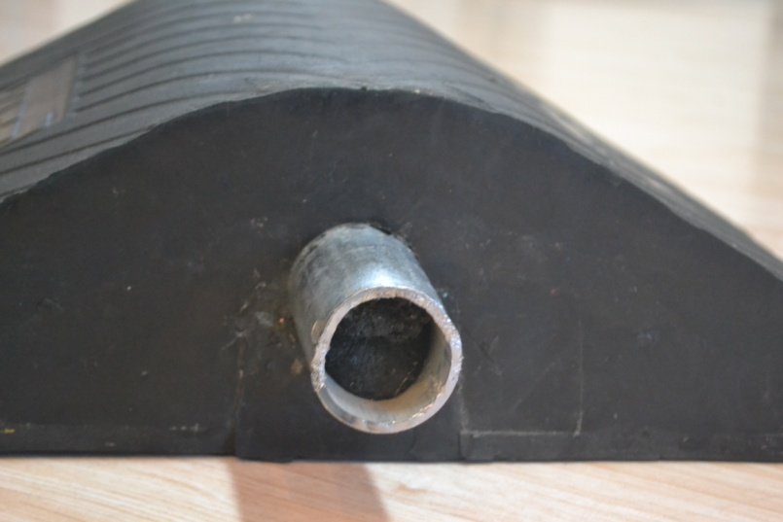
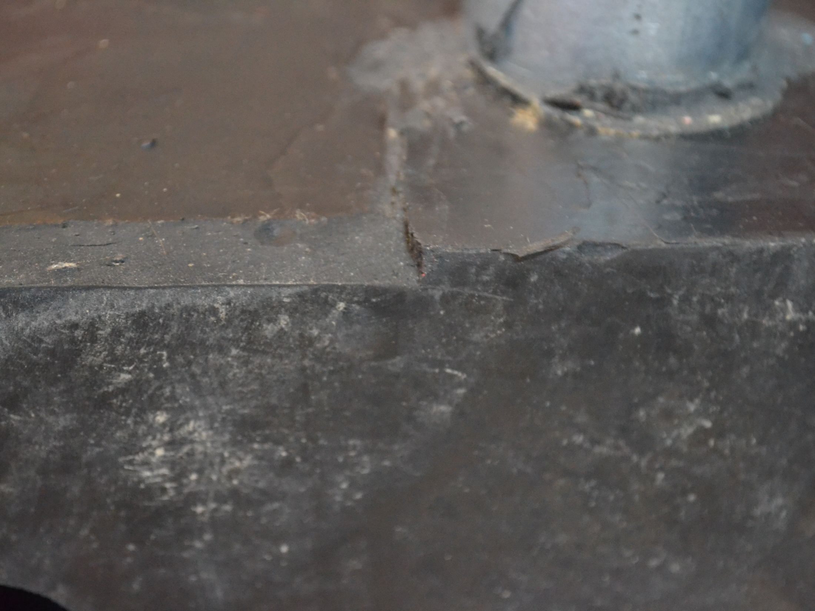
The edge of the rubber counterweight should NOT be damaged

Slide 7
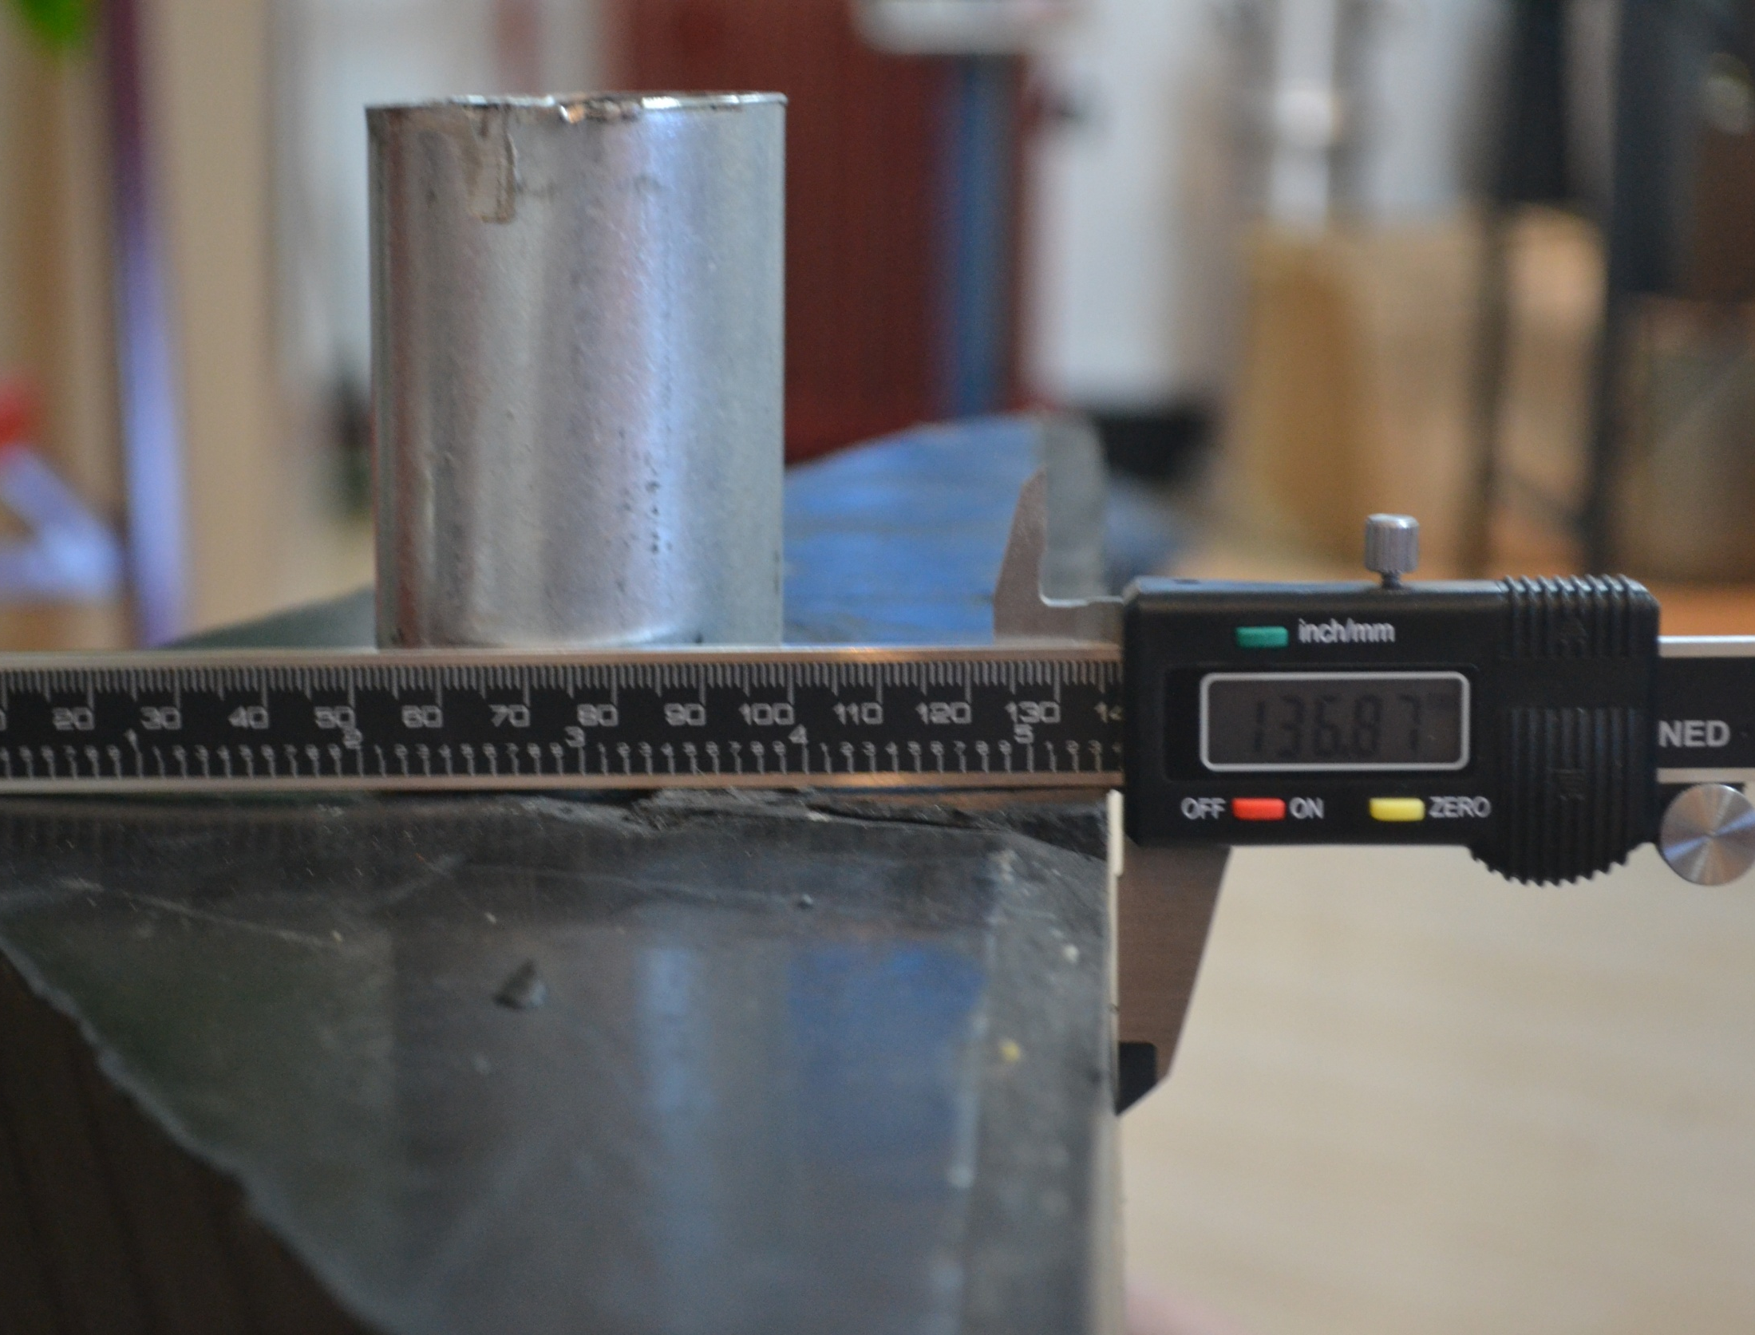
The thikness of the rubber counterweight has to be 130mm (not 136mm).

Slide 8
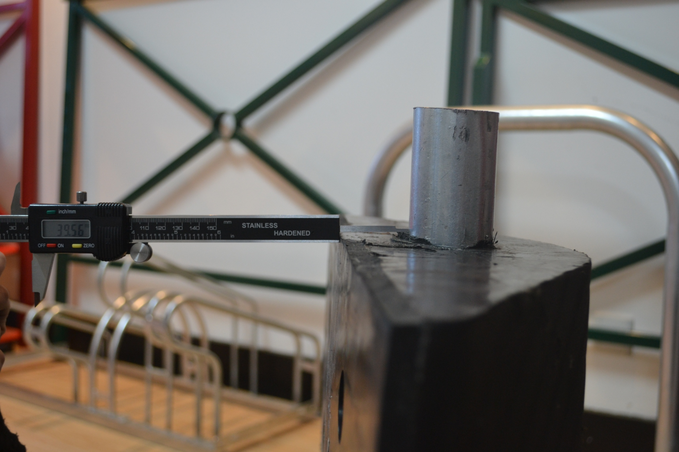
The distance between the bottom of the tube and the ground has to be 30mm (not 39mm).

Slide 9
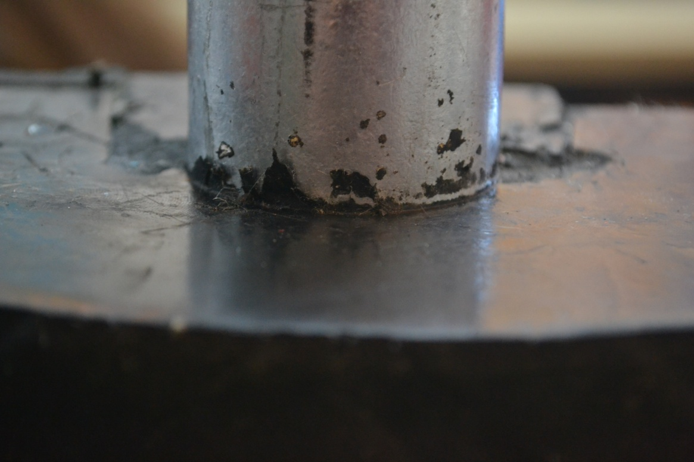
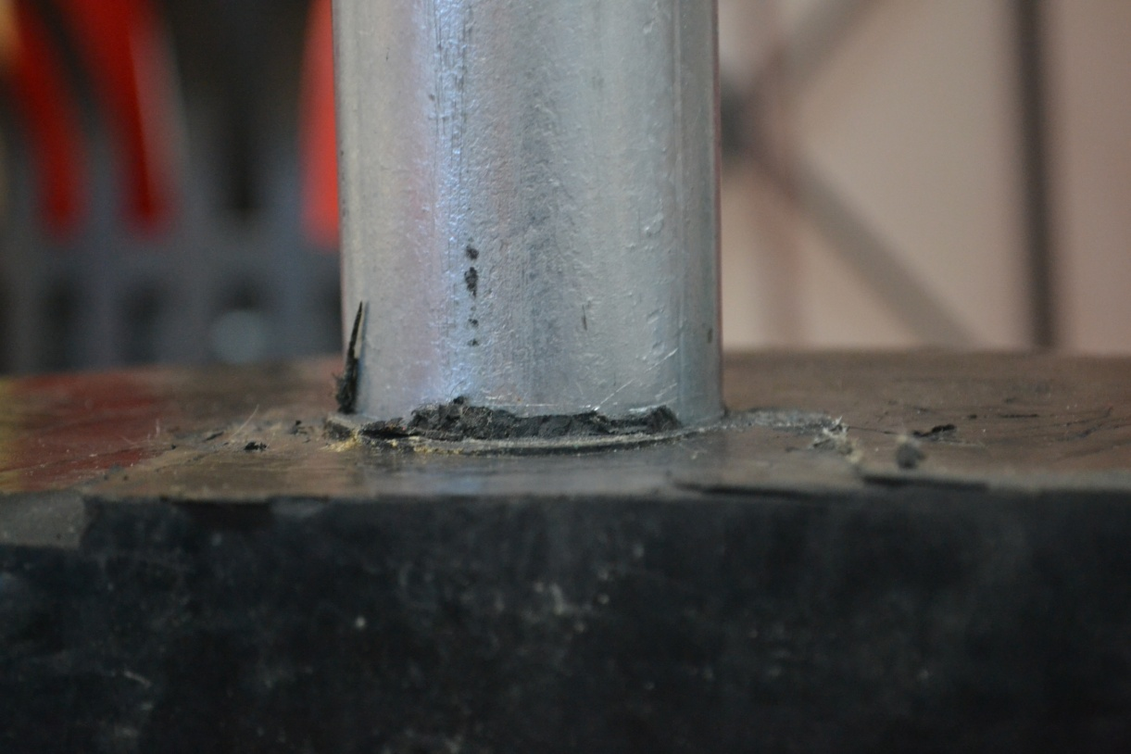
The tube should be clean.

